Slide 1

World News
Welcome to the ELTV World News Admin Environment — an advanced yet user-friendly platform designed to enhance editorial workflow, simplify daily content management, and provide real-time visibility into performance, advertising, and reader engagement.
Every tool has been built to serve the modern journalist and administrator, offering autonomy, precision, and speed in decision-making.
Jordan Capital Group
jcgroupsa.com
info@jcgroupsa.com

Slide 2
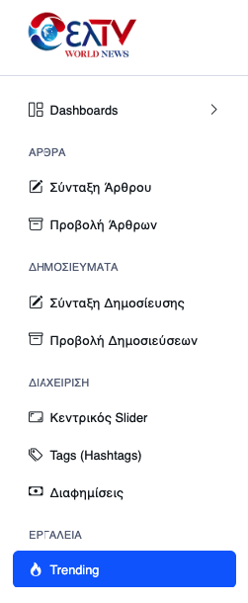
Dashboard Overview
The main menu serves as your central tool, intuitively organized for smooth navigation and immediate access to all core functions of the Back Office. From content creation to performance analysis, everything is in one place:
Article Management: Easily create new articles, preview, edit, or delete existing ones with minimal effort.
Publication Control: Quickly and simply create publications using modern, specialized tools.
Content Promotion: Manage the homepage’s main banner slider, showcasing top news or featured ads that instantly grab the reader’s attention.
Categorization & SEO: Organize and optimize content discoverability through targeted use of tags (also referred to as hashtags).
Advertisement Management: Seamlessly integrate advertisements in designated spots without disrupting the reader or visitor experience.
Trending Analysis: Monitor popular themes across social media and adjust your content strategy accordingly during editorial planning.

Slide 3
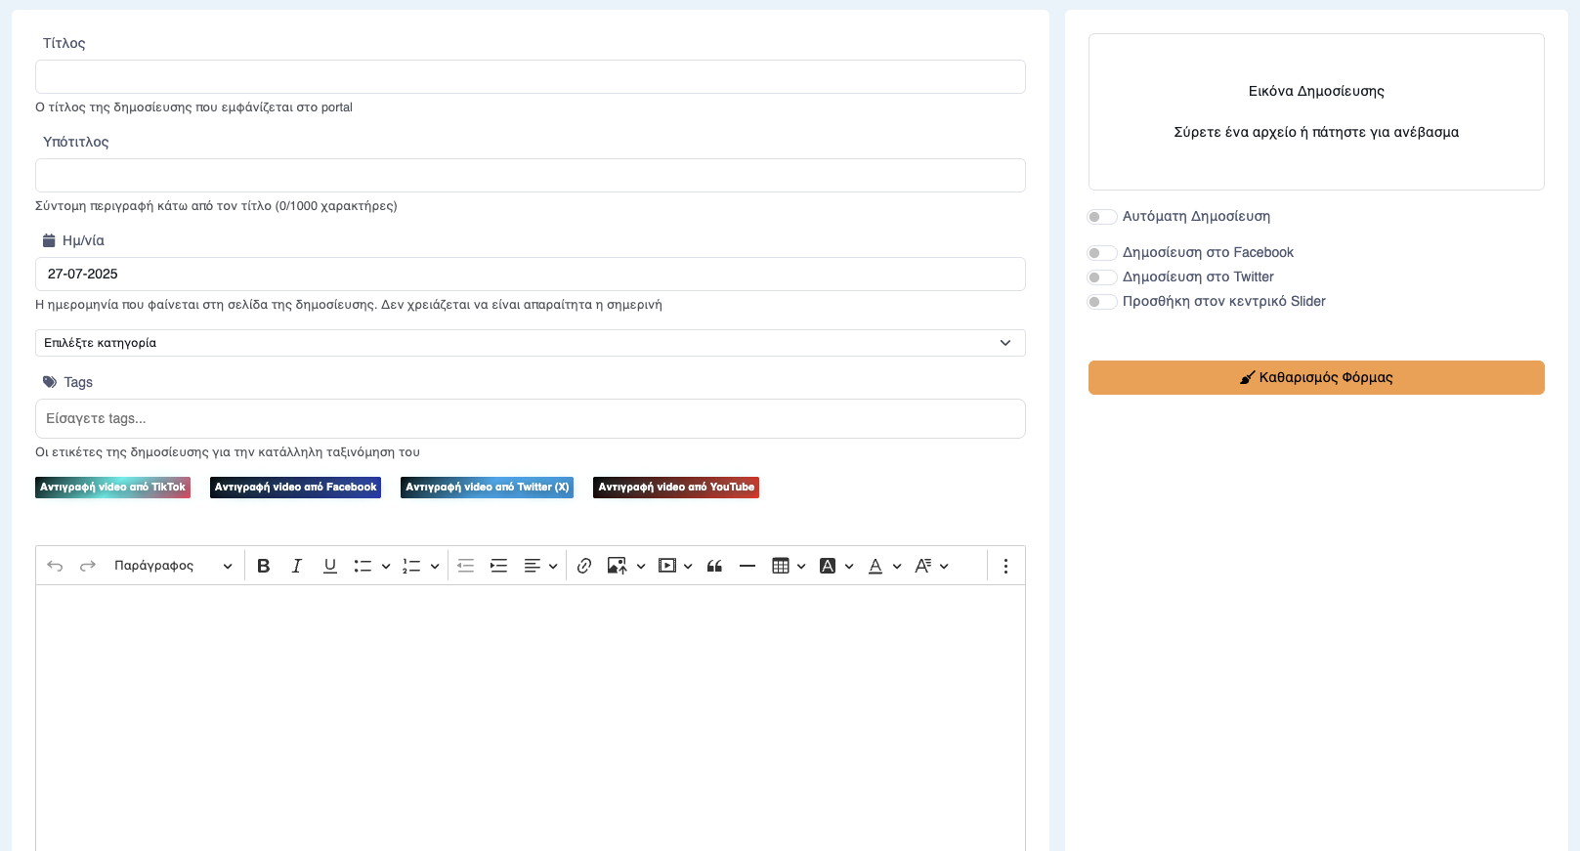
Article Creation & Editing
This is where our content comes to life. With a powerful yet user-friendly rich text editor, our editorial team creates meaningful and well-crafted articles with ease:
Title & Scheduling: Define impactful titles and precisely schedule publication, improving content control and overall editorial strategy.
Categorization & Tagging: Organize articles using categories and tags (hashtags) for better structure and discoverability.
Visual Media Integration: Seamlessly embed videos and images — all within an intuitive text editor.
Social Media Connectivity: Automatically publish content on social platforms like Facebook and X (Twitter), enhancing engagement and reach.
Featured Placement: Highlight important content through the homepage slider, increasing visibility and readership.

Slide 4
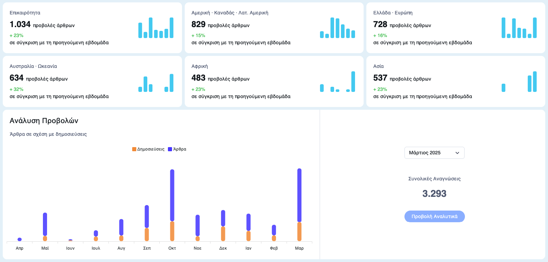
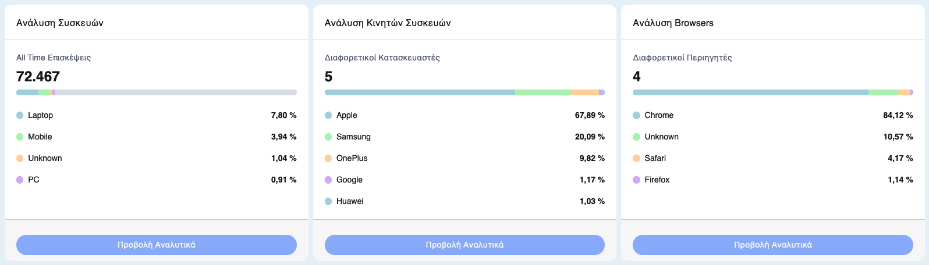
Comprehensive Analytics & Insights
We harness the power of advanced data analysis to gain deep insight into reader behavior, engagement patterns, and the overall performance of our content:
Audience Data: Monitor visitors, user sessions, content views, and traffic trends on a monthly or yearly basis.
Device & Browser Usage: Clearly understand how users interact with the news platform across different devices and browsers, allowing for targeted optimizations.
Geographic & Language Insights: Identify the demographics of our audience — geographic origin and preferred languages — and tailor content to resonate more effectively with diverse audience segments.
Performance Visualization: Charts and graphs present data in a readable format, making complex analytics easier to interpret and supporting informed strategic decisions.

Slide 5
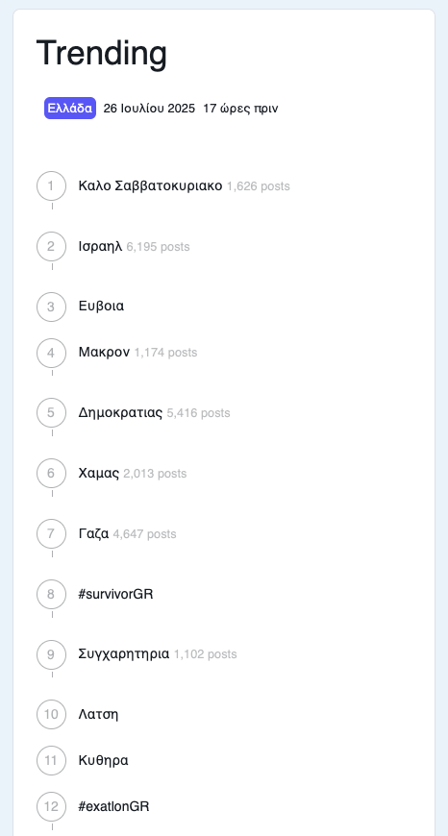
Trending Topics Monitoring
We closely monitor current trends so we can adapt our editorial strategy based on what truly interests our audience:
Real-Time Data: We stay constantly updated with trending metrics, allowing us to identify breaking news early and respond immediately.
Content Strategy: We leverage trends and hashtags to craft articles that capture attention, increase engagement, and boost traffic across our platform.

Slide 6
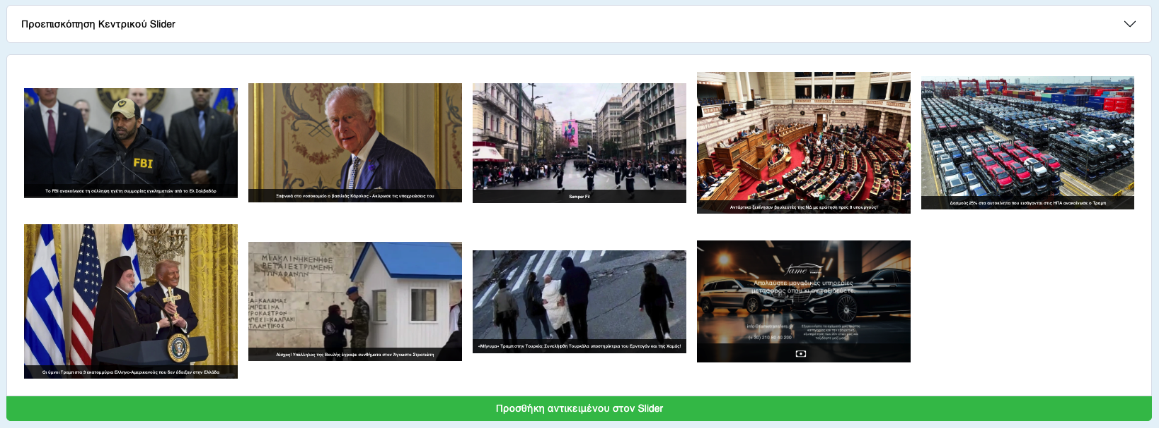
Homepage Slider Customization
We capture the attention of our readers with dynamic and visually striking content placed prominently on our homepage:
Easy Item Management: We effortlessly add, rearrange, or remove items from the slider, strategically highlighting key content.
Optimized Visual Presentation: We easily adjust image cropping and placement to ensure that featured content appears attractive and professional.

Slide 7
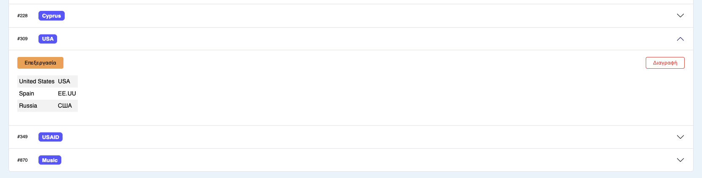
Tag Management & SEO Optimization
We simplify and organize our tags (hashtags) to improve indexing and enable more efficient content management:
Full Tag Control: We easily add, edit, remove, and translate tags, maintaining a clear and well-structured content hierarchy.
SEO Benefits: Proper tagging directly enhances the SEO performance of our news platform, boosting both content discoverability and readership.

Slide 8

Advertisement Control Center
We fully leverage the advertising potential of our platform using smart management tools — all without compromising the reader experience:
Flexible Ad Creation: We quickly create new ads by uploading images, setting custom URLs (web links), and applying precise visibility settings.
Performance Control: We easily edit existing campaigns, adjust display frequency, or promptly remove outdated advertisements.

Slide 9
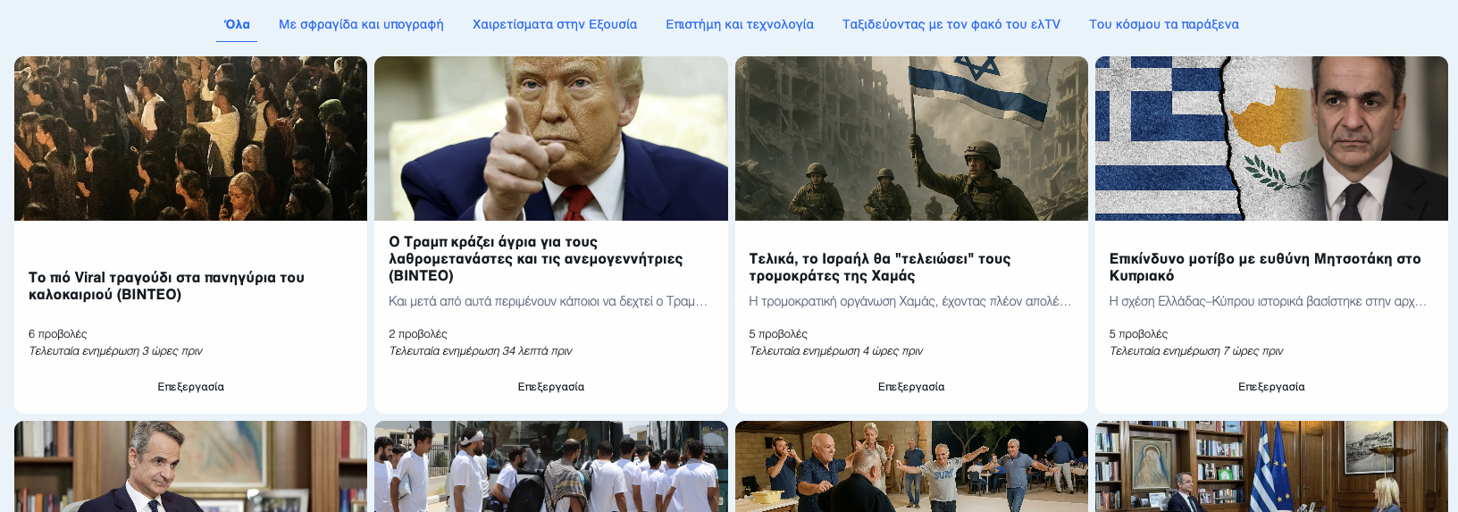
Category-Based Content Display
We enhance the reader experience by organizing content through both geographical and thematic filters:
Geographical Categorization: We display news by region (such as Europe, America, Asia), significantly increasing engagement among targeted reader groups.
Thematic Presentation: Clearly structured sections — including science, technology, travel, and photography — effectively attract audiences with specialized interests.

Slide 10
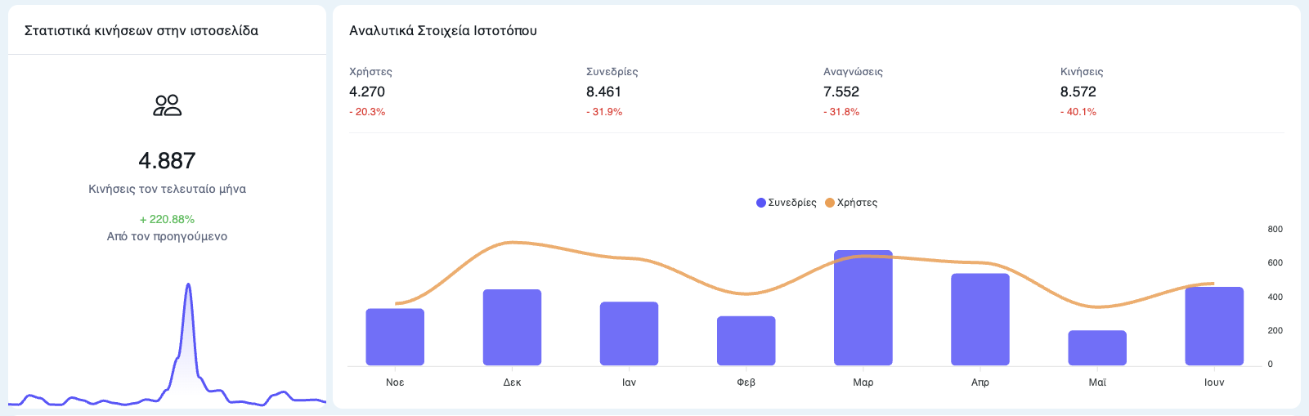
Advanced Analytical Reports
We conduct in-depth analysis of visitor data through advanced reports, gaining a complete understanding of content performance and audience engagement:
Comparative Analysis: We compare the performance of articles and publications to refine and improve our editorial strategy.
Historical Insights: We utilize historical data to identify long-term trends and proactively adjust our content strategy.

Slide 11

Empowering the Editorial Workflow
The ELTV World News Back Office documentation ensures that our editorial team is fully equipped to manage content strategically, deeply understand its audience, and operate the news flow at maximum efficiency. Every feature is thoughtfully designed to keep you informed, organized, and effective — making the editorial workflow smooth and enjoyable.

Slide 12
World News
Thank you sincerely for your attention.
With advanced management tools, real-time analytics, and full content control, we are bringing the next era of Greek news — for the diaspora and beyond — closer than ever.
The future of news is being built right here.
Sincerely,
The ELTV Team
Jordan Capital Group
jcgroupsa.com
info@jcgroupsa.com

