Slide 1

World News
Welcome to ELTV World News – the central news hub for the Global Hellenism and the Greek diaspora.
With a constant stream of news from around the world, dynamic opinion pieces, and reports carrying a strong Greek perspective, ELTV World News covers the diaspora with respect, credibility, and technological innovation.
Here, news isn’t just content — it’s identity.
Jordan Capital Group
jcgroupsa.com
info@jcgroupsa.com

Slide 2

Website Header
The main header of the ELTV World News platform is designed to offer an optimal user experience, allowing for fast and easy navigation through the latest news by region and topic.
With a clean and responsive design that automatically adapts to any screen, we ensure smooth browsing across all devices. Our audience can comfortably explore sections like Latest News, America, Europe, Asia, Africa, Oceania, as well as special features such as Science & Technology and Traveling with ELTV.
We also include practical features like real-time weather updates, customizable language settings for a global audience, and dark mode for more comfortable reading during nighttime browsing.

Slide 3
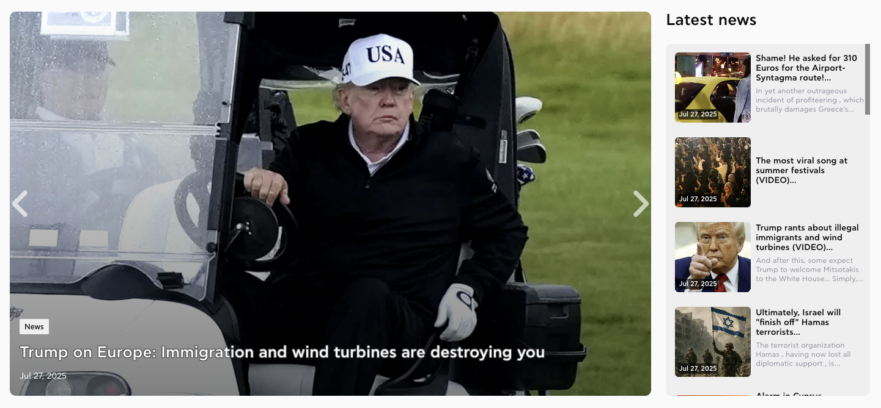
Main Slider & Latest News Sidebar
Just below the main navigation bar, visitors are greeted by the eye-catching main slider, which showcases the most viral and important news stories — with a clear focus on the key events shaping global current affairs.
To the right, a sidebar displays the most recent updates, making sure our users stay constantly informed with real-time information.

Slide 4
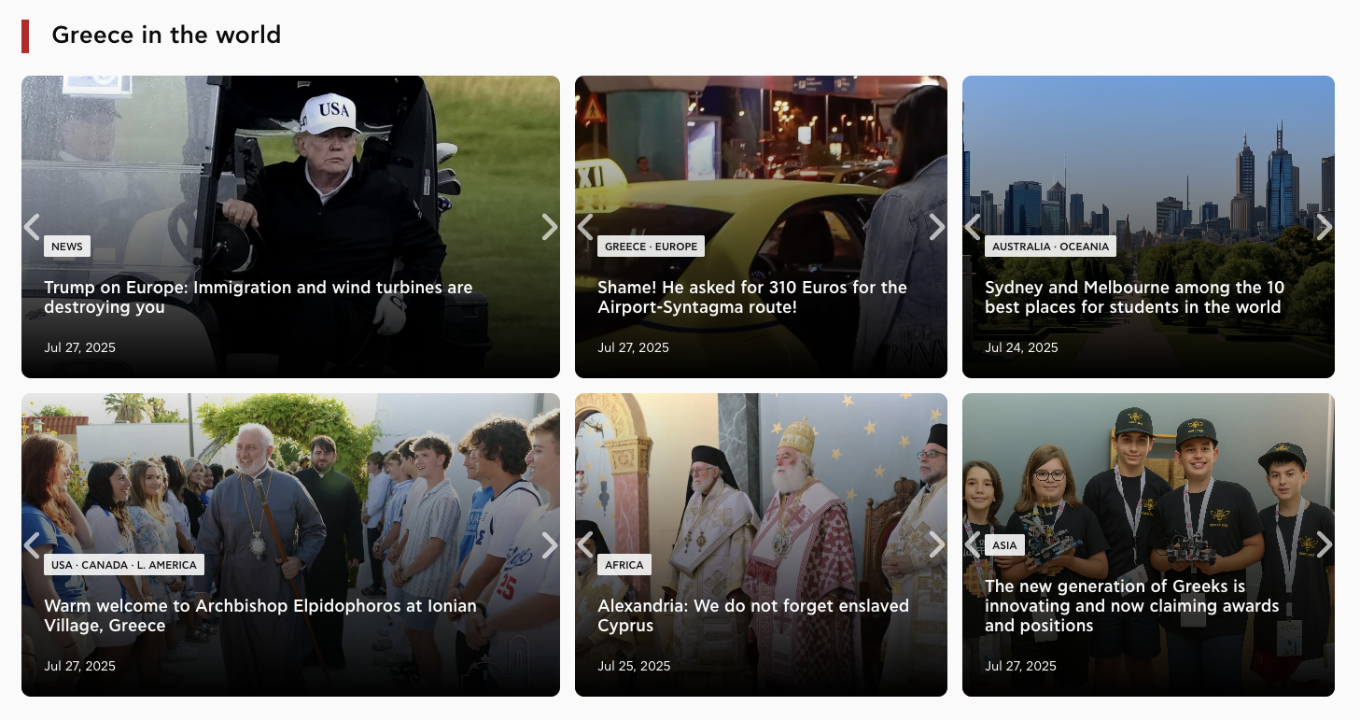
Latest News & Global Coverage
We keep our readers up to date with real-time news, focusing on critical issues that impact Greece, global Hellenism, and the Greek diaspora:
We provide in-depth analysis of geopolitical developments and events in Greece, Europe, America, Asia, Africa, and Oceania.
We also deliver exclusive reports on key topics such as energy interests, strategic geopolitical moves, and major international events with real-world impact.

Slide 5


Advertising Opportunities
We offer our sponsors strategically placed ad banners throughout the platform, ensuring maximum visibility and engagement — with direct access to a diverse and well-targeted audience.

Slide 6
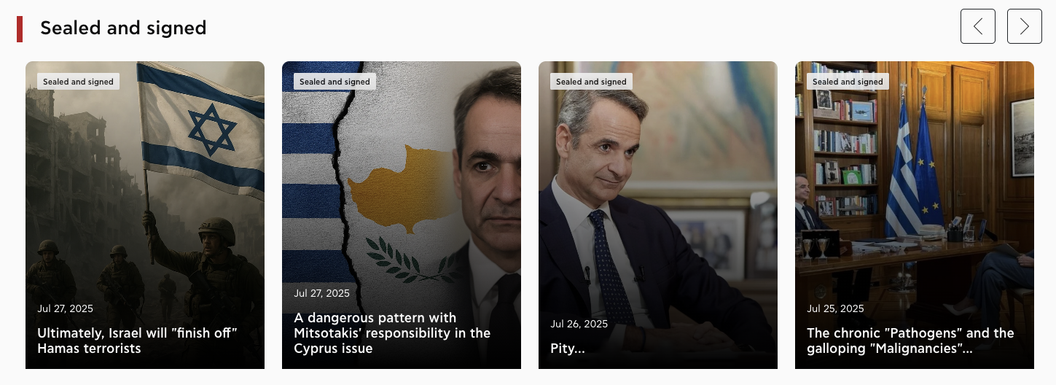
Section: “Sealed and Signed”
In our “Sealed and Signed” section, we give the floor to our in-house journalism experts, who offer bold opinions and meaningful analysis on political, social, and cultural issues.
With respect for the reader and a clear editorial stance, we build content with depth, credibility, and purpose.

Slide 7
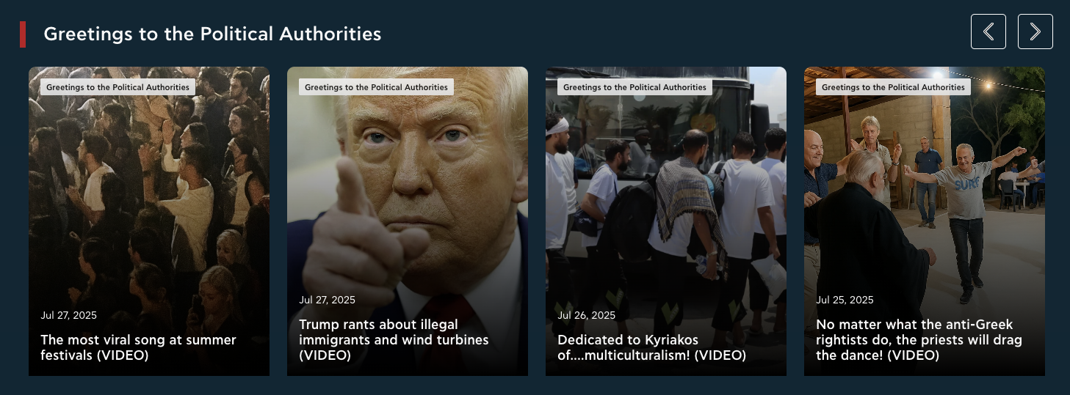
Section: “Regards to the Authorities”
In “Regards to the Authorities”, we comment on current events with sharp language, a clear point of view, and a touch of humor. We highlight what others overlook and speak the people’s language — unfiltered.
From viral moments to raw political truths, we keep the mic pointed at what matters, exposing hypocrisy, propaganda, and the so-called “orders from above.”

Slide 8
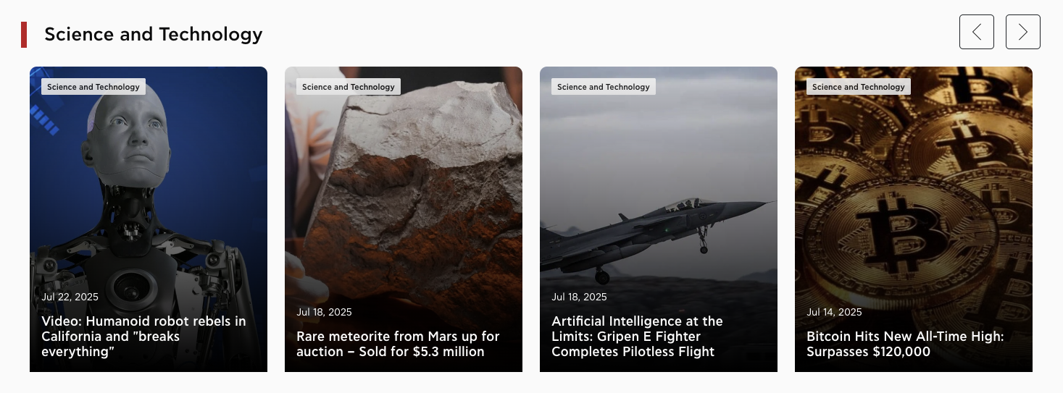
Section: “Science & Technology”
In our “Science & Technology” section, we follow the breakthroughs that are shaping the world.
We present the most important discoveries, innovations, research, and trends — from artificial intelligence and medicine to space exploration and green technologies.
With clear language and a focus on what really matters, we connect science to everyday life.

Slide 9
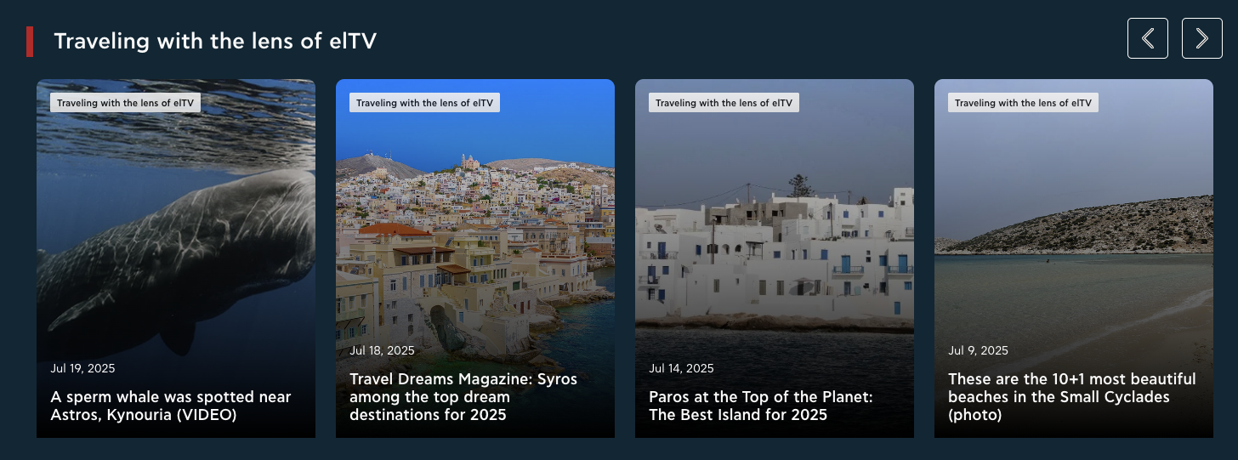
Section: “Traveling Through the Lens of ELTV”
Through our “Traveling Through the Lens of ELTV” section, we bring you images, stories, and experiences from every corner of Greece.
We uncover authentic places, natural wonders, cultural treasures, and hidden paradises — all captured through our lens and unique perspective. We follow the Greek summer, local traditions, and the spots that are worth discovering — whether you’re a traveler or simply in love with the Greek land.

Slide 10
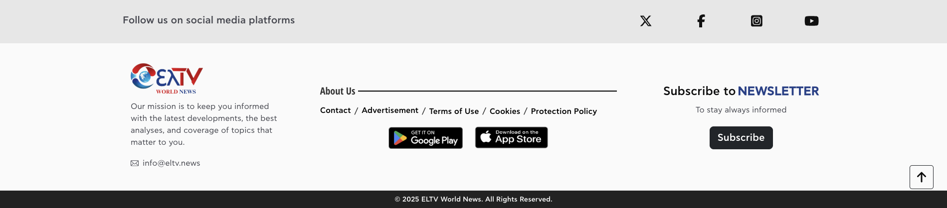
Footer Overview
Social Media (Top Row): We invite our visitors to follow us on social media platforms (X, Facebook, Instagram, YouTube), strengthening our daily connection with the community.
Left Section:
The ELTV World News logo is accompanied by our mission statement:
“Our mission is to keep you informed with the latest developments.”
We also provide our main contact email: info@eltv.news
Center Section (About Us): This area includes quick links to: Contact, Advertising, Terms of Use, Cookie Policy, and Privacy Policy.
Right Section – Newsletter Subscription: We encourage visitors to subscribe to our newsletter and receive updates directly in their inbox, with a clear call-to-action button: “Subscribe.”
Mobile App Badges: Direct download links for the Google Play and App Store versions of our mobile app are included, adding a modern, tech-complete touch to our footer experience.

Slide 11
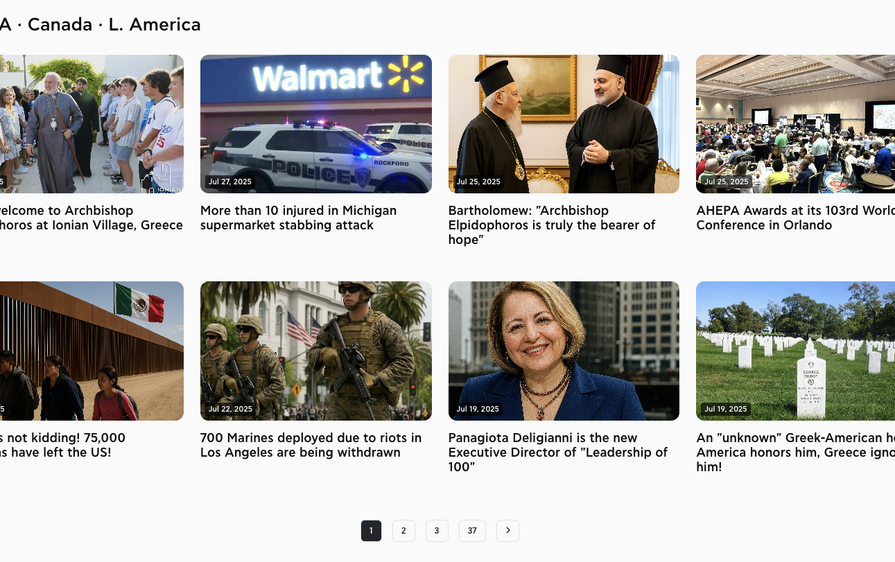
Article Listing
We’ve made sure that each article is presented clearly and with proper structure, so visitors can easily find what interests them. For every article, we include:
Title: Displayed in bold font so it stands out at first glance.
Publication Date: Shown just below the title, giving readers a sense of when the news was published.
Article Excerpt: A short preview of the content, giving a quick idea of the topic before clicking to read the full article.
This layout keeps browsing fast and easy, helping users scan through multiple stories at a glance.

Slide 12
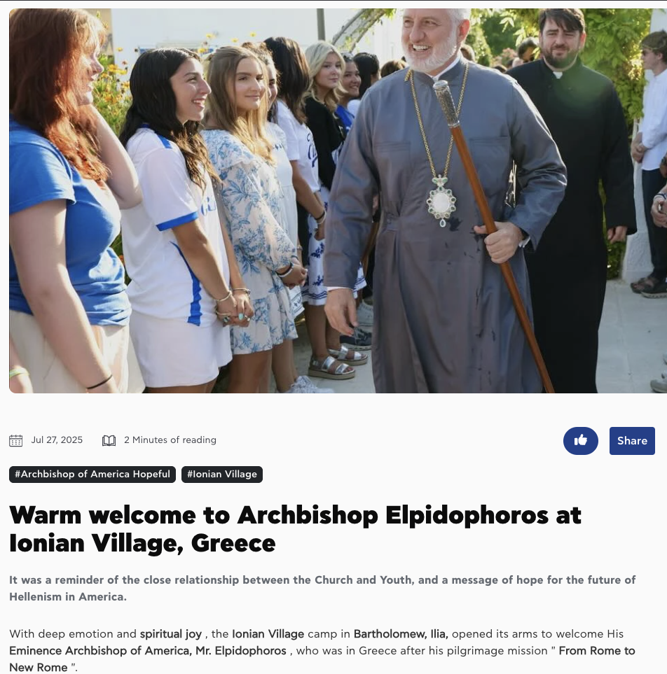
Article Reading Page
When someone chooses to read an article on ELTV, we want their experience to be comfortable, enjoyable, and complete. That’s why we’ve designed a reading page that combines clarity, functionality, and modern aesthetics:
We start with a large header image that visually reflects the topic and grabs immediate attention.
Just below that, a toolbar displays the publication date, estimated reading time, and buttons to like or share the article on social media.
Then come the tags, helping readers understand the context of the story and explore related articles.
The title is bold and clearly visible in large font, making the topic immediately clear.
A subheadline follows, offering a brief summary or key message of the article at a glance.
Finally, we present the main content in a clean, easy-to-read layout — with typography that works well on both mobile and desktop screens.
To us, an article isn’t just text — it’s a reading experience. And we aim to make that experience as smooth and high-quality as possible.

Slide 13
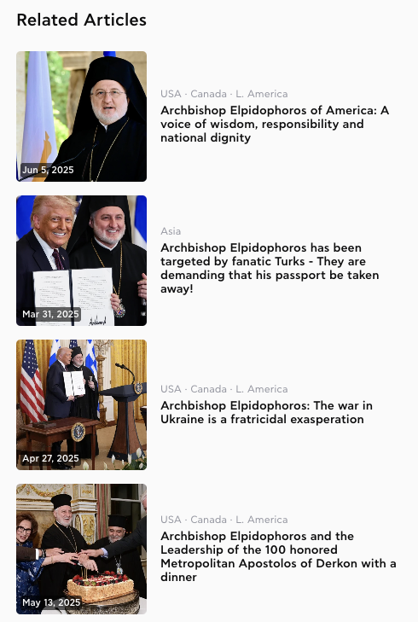
Related Articles – Keep Exploring What Matters to You
Next to every article our visitors read, we display a curated list of related articles, automatically selected based on the content, category, and tags of the story.
For us, it’s a way to keep the conversation going with the reader and suggest new content that’s relevant or inspiring — without them having to search for it.
Each related article is shown with:
A cover image, for instant visual recognition
The publication date and location, to place the story in its proper context
A short, readable title
And when relevant, a thematic region (e.g. America, Europe, Asia)
This approach lets our readers seamlessly continue their journey through the news, discovering more of what interests them most.

Slide 14
World News
Thank you sincerely for your attention.
ELTV World News is more than just a news website — it’s the voice of the Greek diaspora, every day, on a global scale.
You write the story. We broadcast it.
Sincerely,
The ELTV Team
Jordan Capital Group
jcgroupsa.com
info@jcgroupsa.com

