Slide 1



Mobile App
ELTV on Your Mobile – Stay Informed and Connected with Hellenism, Wherever You Are
The official ELTV app brings Greek news from around the world straight to your hands — including breaking stories, in-depth reports, opinion pieces, and cultural features, all designed for the Greek diaspora and the modern Greek citizen.
At the same time, it gives you access to Greek points of interest (Places), job listings (Jobs), travel deals (Travel), and business tools (Business) — all integrated into one easy-to-use environment, built for everyday use.
ELTV is your global connection to Hellenism.
Jordan Capital Group
jcgroupsa.com
info@jcgroupsa.com

Slide 2
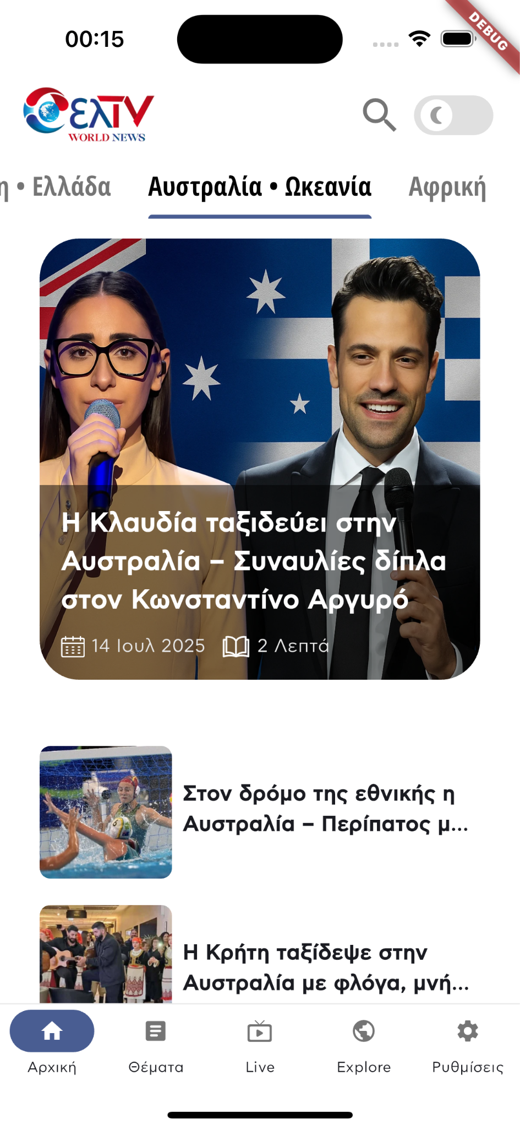
The First Screen Says It All
The moment you open the app, you get instant access to the most important news from Greece and the global Greek community.
Browse topics by continent and country, watch live content, explore curated categories, and follow stories that connect Greece with the rest of the world.
Everything starts from the home screen — designed to keep you informed and connected to the Greek world.

Slide 3
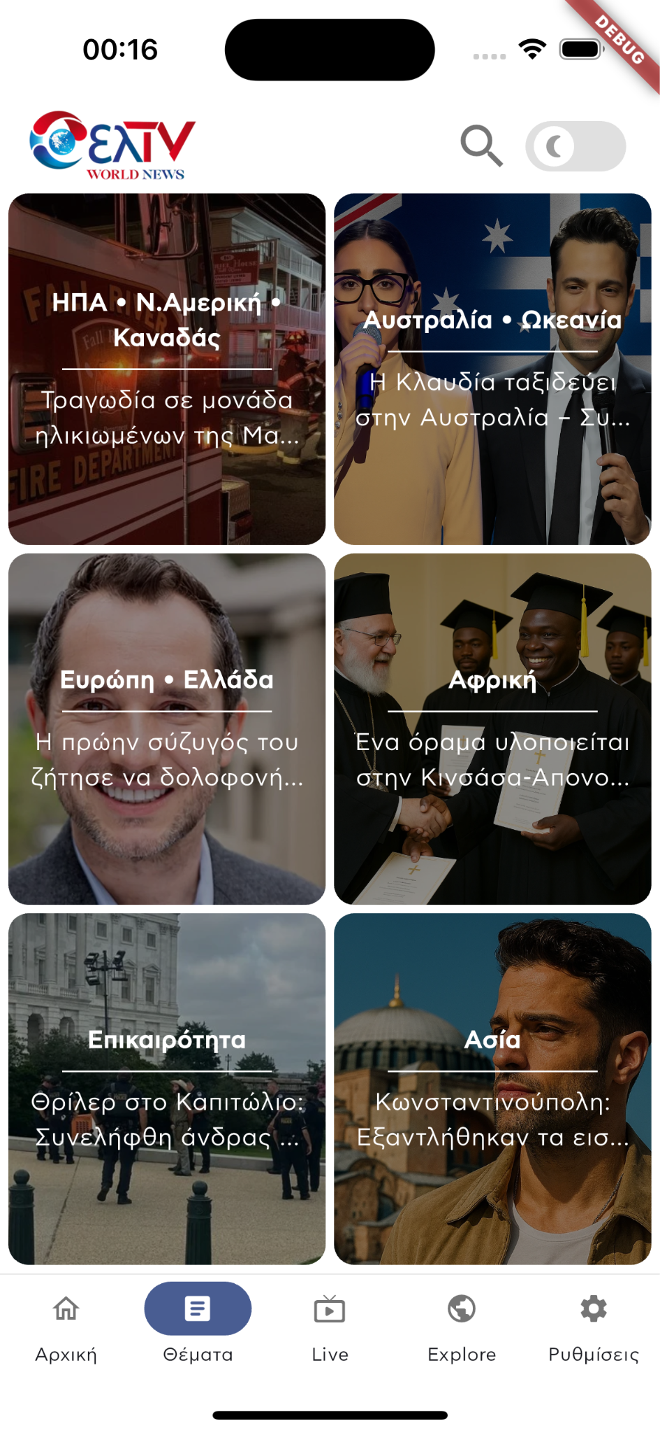
The Entire Greek Diaspora, Organized by “Topics”
With the Topics tab, staying informed becomes focused and relevant. Users can easily select the continent or theme they’re interested in — from Europe and Australia to Asia, Africa, and the U.S. — and read articles that specifically relate to Hellenism in each region.
It’s a fast, visually clear browsing experience, helping you find exactly what matters to you — right when you need it.

Slide 4
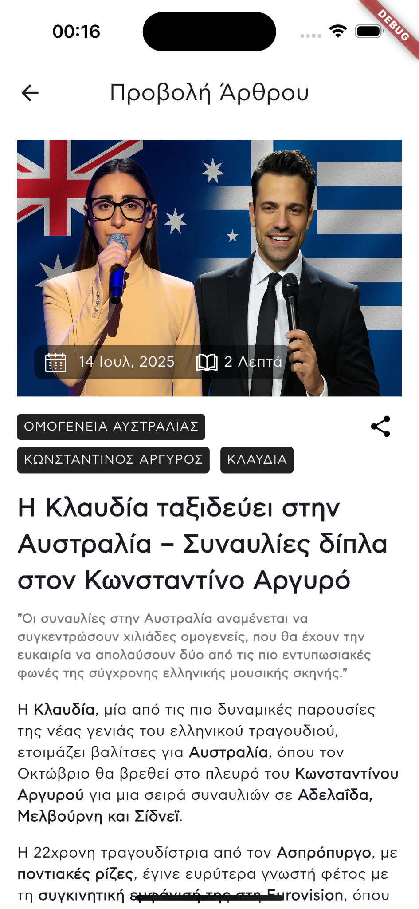
Articles That Don’t Just Get Read — They Come to Life
The article view is designed for a clean, comfortable, and focused reading experience. With refined typography, high-quality visuals, and topic-based tags, readers can easily immerse themselves and explore related content.
High-resolution images & clear thematic focus
Publication date & estimated reading time
Tags for quick navigation
Smooth, enjoyable reading on mobile
Content focused on the Greek diaspora

Slide 5
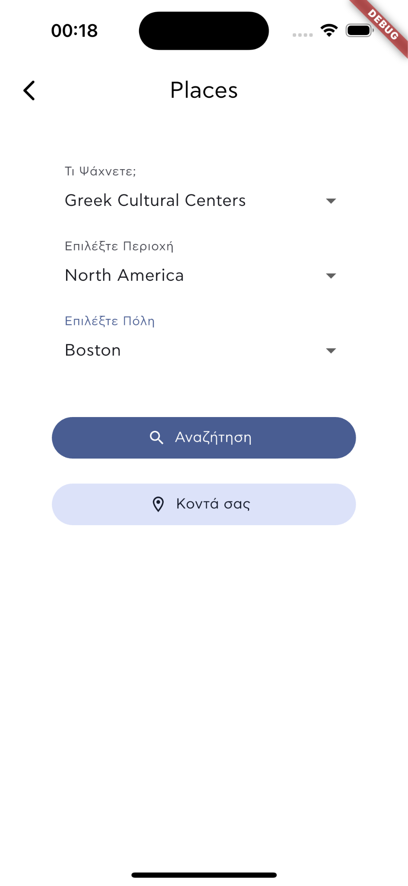
Discover Greek Places, Everywhere
With ELTV Places, you can browse by category — such as cultural centers, churches, restaurants, and more — and explore Greek points of interest by region and city around the world.
Or simply tap “Near You” to instantly find Greek locations close to your current position.

Slide 6
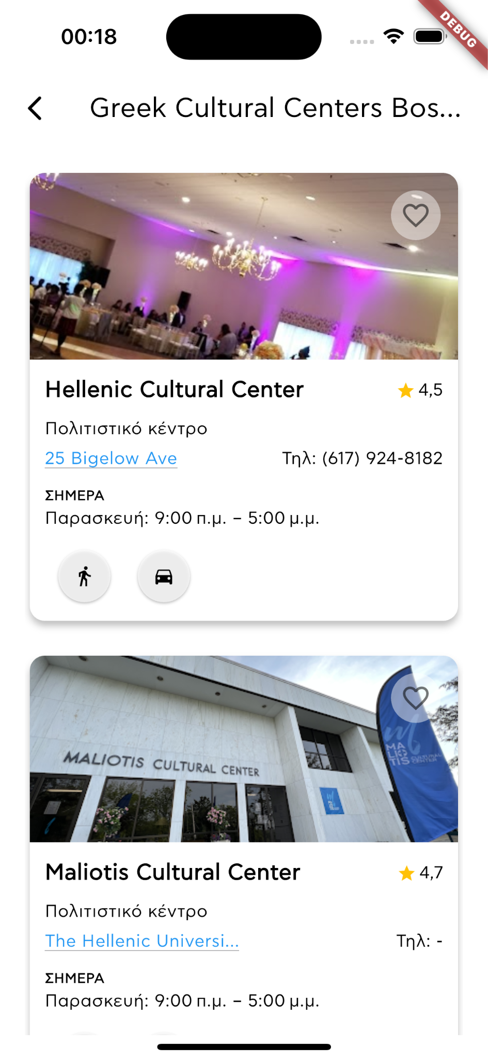
Greek Points of Interest in Every City Around the World
The ELTV Places results view offers fast, organized access to Greek cultural centers, businesses, shops, and landmarks tied to Hellenism — wherever you are.
Each listing card includes key details: name, type, address, phone number, opening hours, navigation options, and user reviews.
Users can also save favorite locations and easily plan their visits.
User-friendly interface focused on clear info
Ratings & hours for immediate usability
Walking or driving navigation support
Option to save places to favorites
A must-have tool for the Greek diaspora & travelers

Slide 7
Mobile App
Thank you sincerely for your attention.
The ELTV Mobile App Is More Than Just News or Maps
It’s a complete ecosystem for Hellenism around the world.
From news and culture to business, jobs, and travel, we’re building a digital network that brings the global Greek community together.
Sincerely,
The ELTV Team
Jordan Capital Group
jcgroupsa.com
info@jcgroupsa.com

