Slide 1

World News
Places
Jobs
Travel
Business
The all-in-one platform for the Greek Diaspora and Global Hellenism.
From the news and broadcasting of World News, to Greek points of interest such as historical landmarks, shops, and businesses through Places.
From job listings in Jobs, to travel deals in Travel, and with Business, every company gains exposure, tools, and access to the full ELTV ecosystem.
Jordan Capital Group
jcgroupsa.com
info@jcgroupsa.com

Slide 2

World News

Slide 3
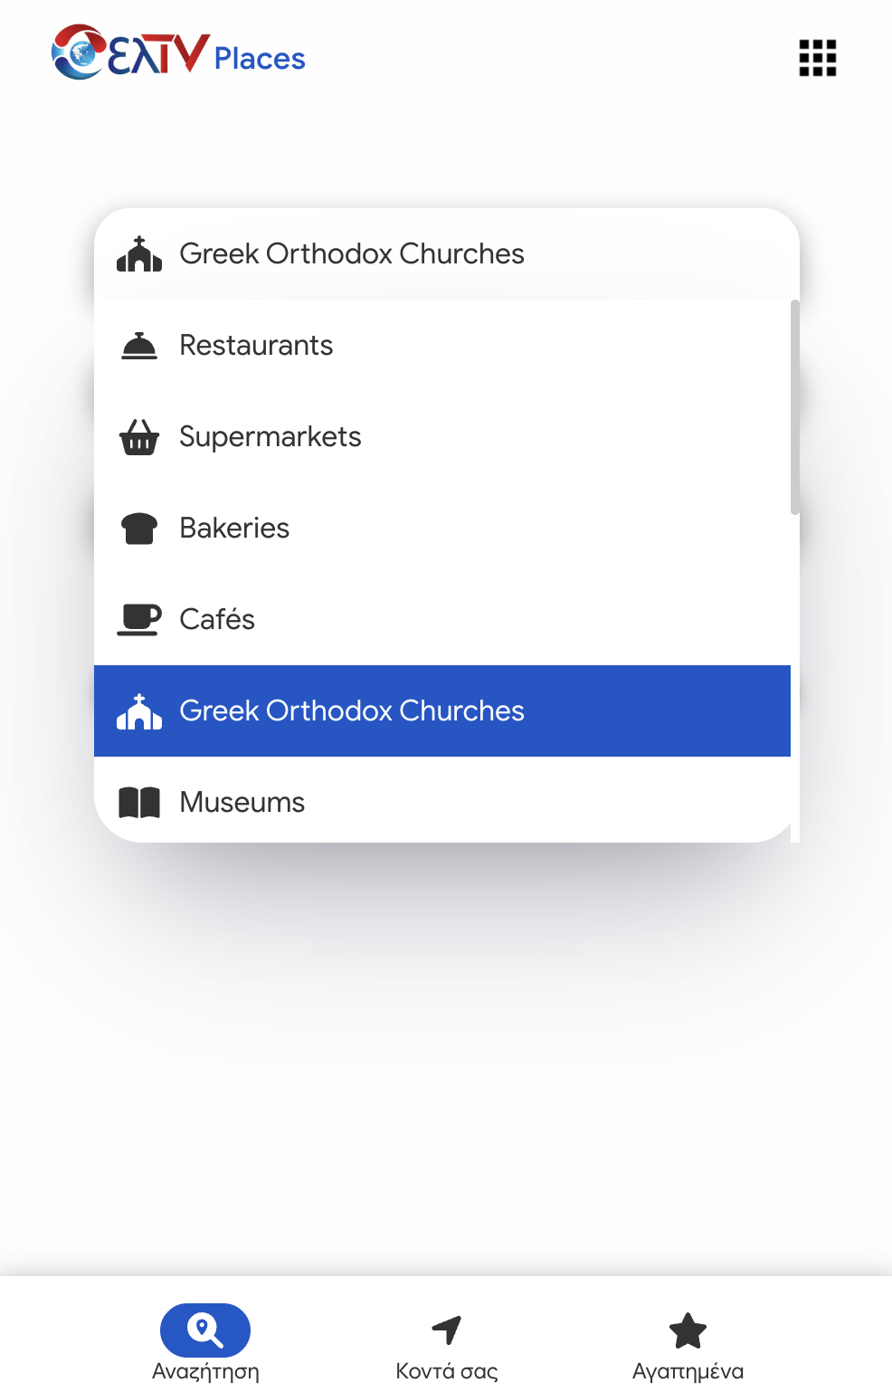
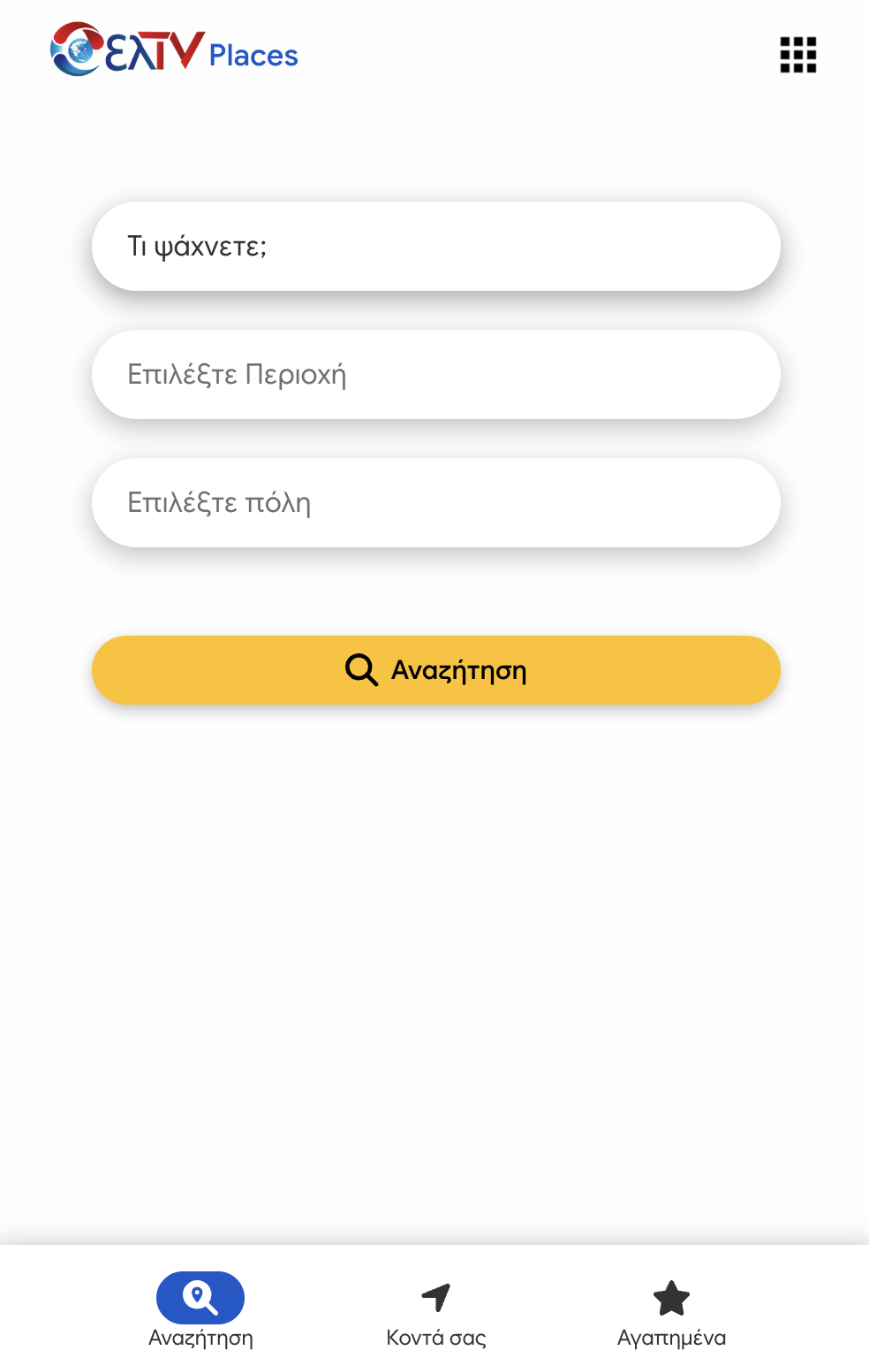
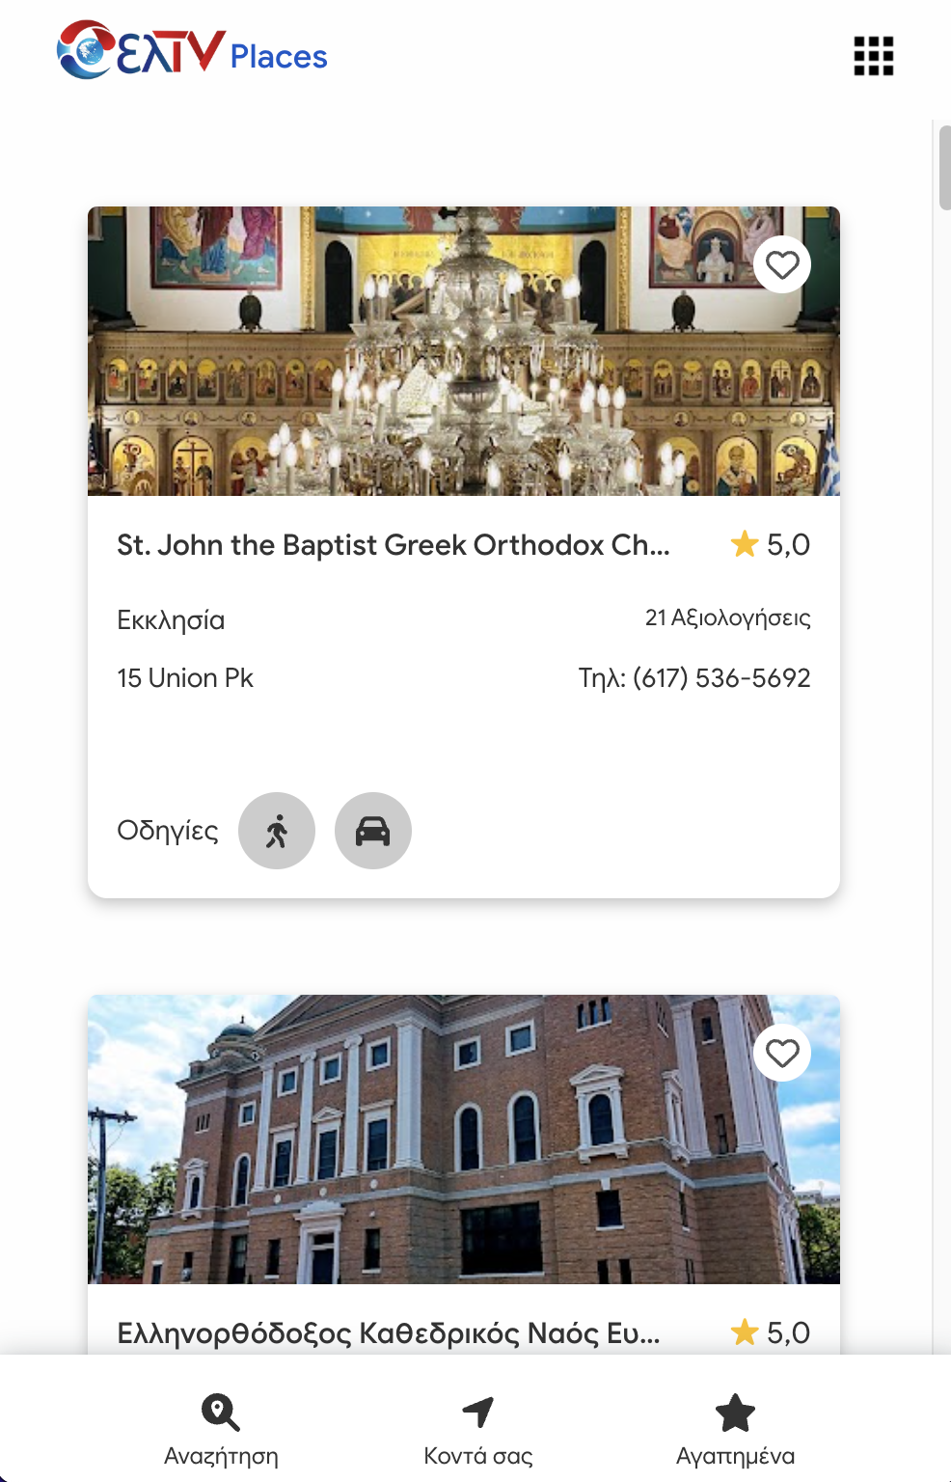
Places

Slide 4
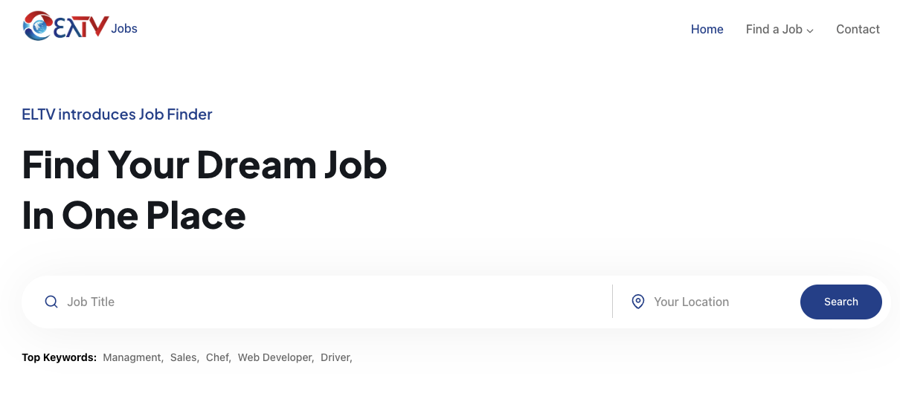
Jobs

Slide 5
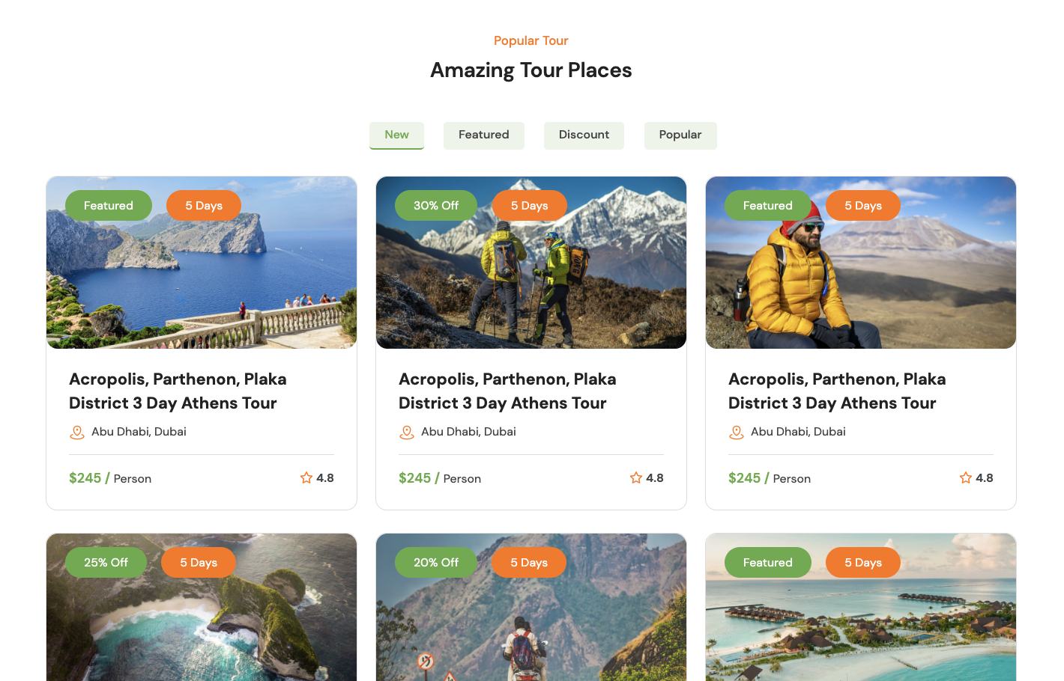
Travel
Example of implementation

Slide 6

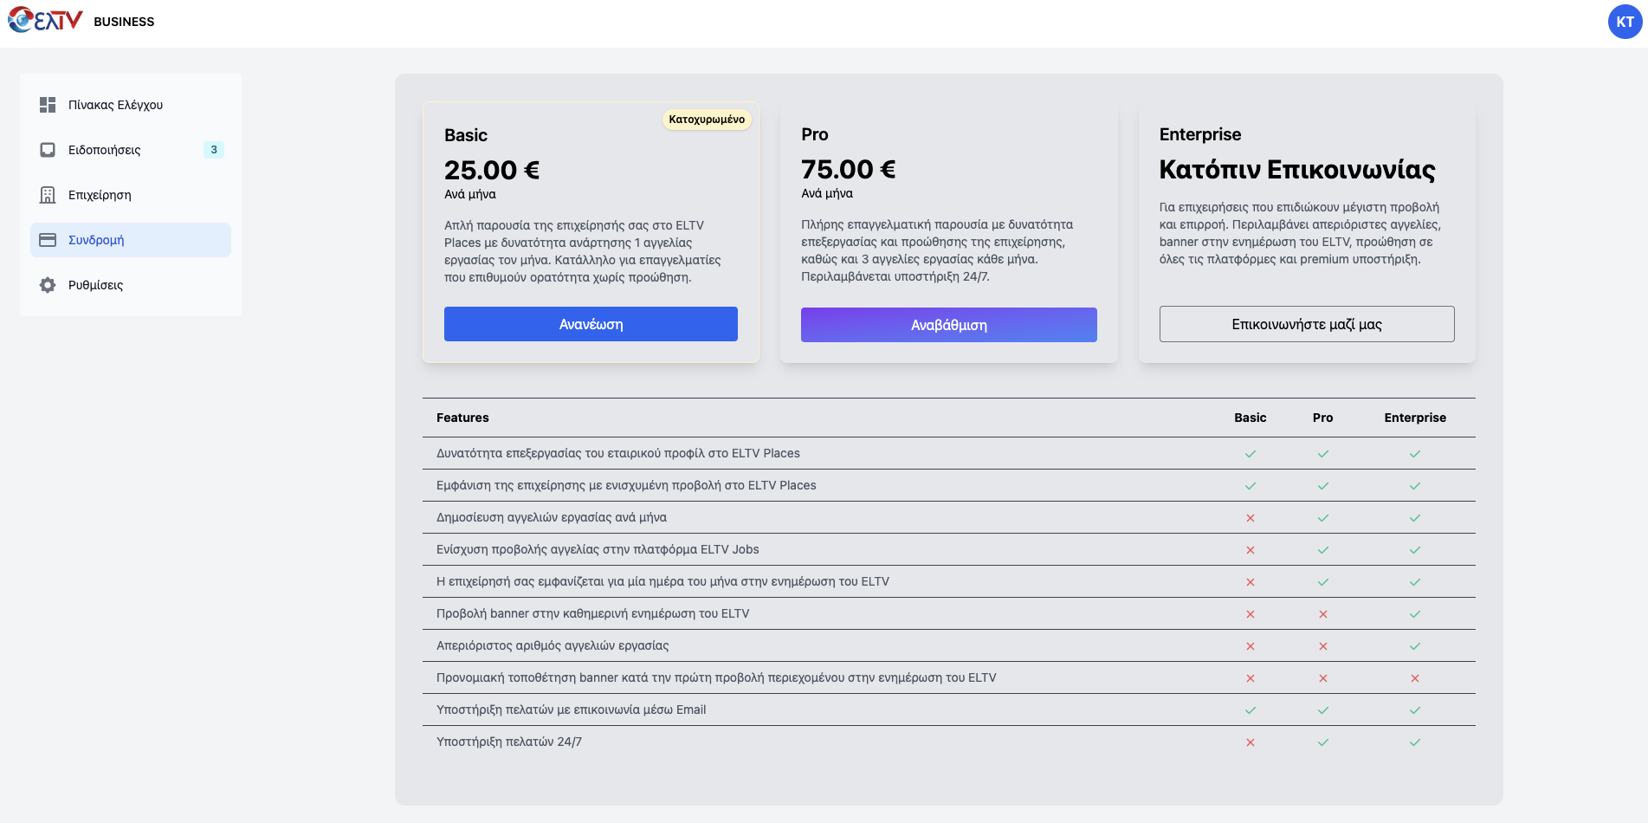

Slide 7
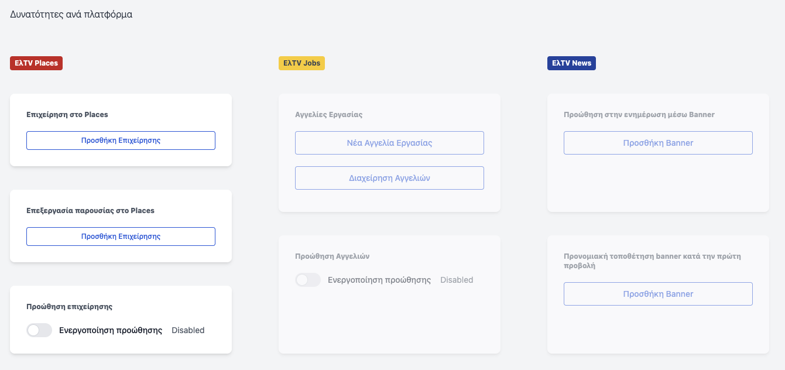
Business Registration
Business Promotion
Job Listings
Advertising in the News Section
Banner Ad

Slide 8
World News
Places
Jobs
Travel
Business
Thank you sincerely for your attention.
ELTV is not just a digital platform — it’s a bridge connecting Greeks around the world with their homeland, with news, opportunities, and entrepreneurship.
With an ecosystem of tools and content designed specifically for the diaspora and the modern Greek, we’re building a digital space for connection, collaboration, and growth — every single day.
Sincerely,
The ELTV Team
Jordan Capital Group
jcgroupsa.com
info@jcgroupsa.com

